Slide 1

Master thesis November meeting
Jesse Keränen
12.12.2023

Slide 2
Progress during November
Data collection is almost ready
Still planning to collect trading volume data
Applied both static and dynamics screens
Downloaded everything in local currency
Downloaded also FX-rates for each currency and converted RI and MV to US dollars
Rest of the variables handled in local currency
Risk free rate from Kenneth French database
Started to write the scripts for the empirical analysis

Slide 3
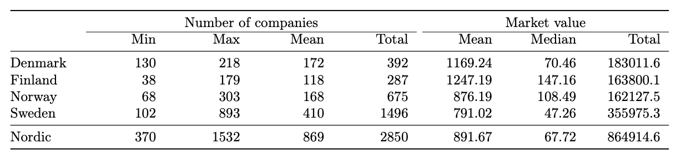
Remarks from the data
Sweden is the biggest, but not dominant
Companies are small compared to US data
Momentum factor most promising
Included multiple momentum variables
Rest of the FF factors do not show significant returns

Slide 4
Next steps
Finalize the set of predictive variables
Including additional momentum variables
On balance colume
Illiquidity
Continue working on the code for the expected returns.

Slide 5
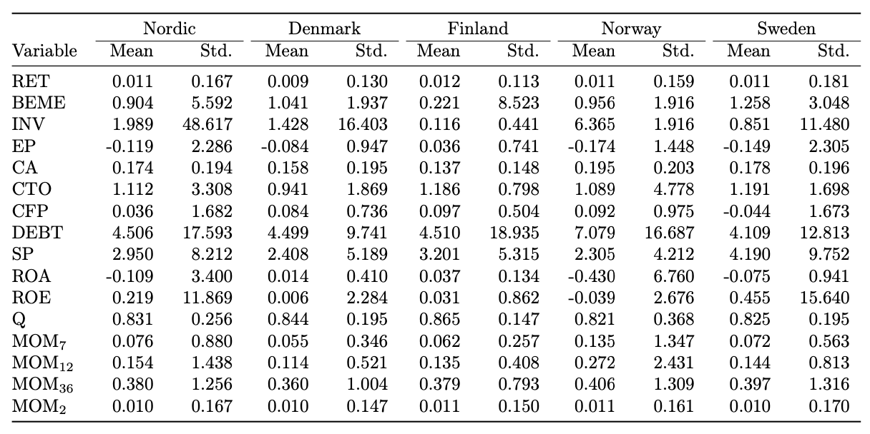
Summary statistics

Slide 6
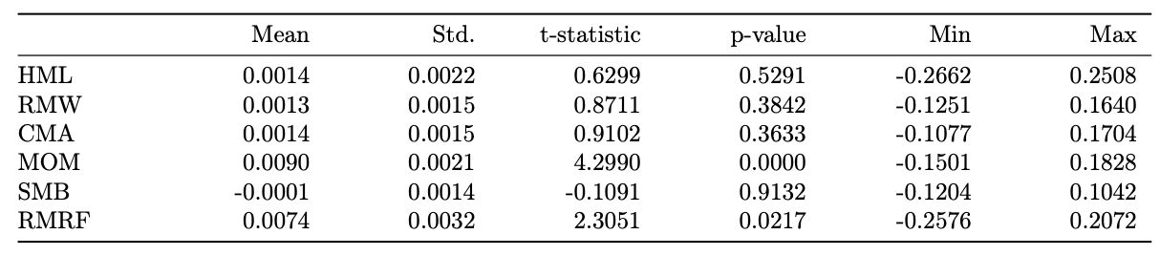
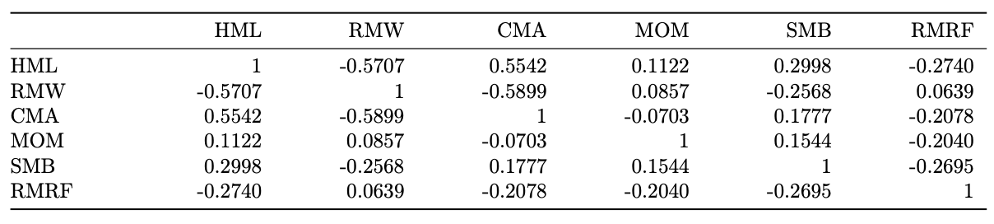
Factor statistics
Correlation matrix

Slide 7
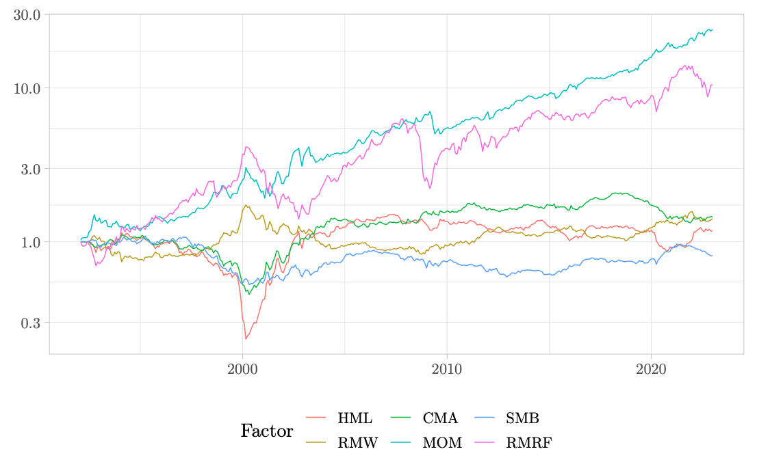
Factor performance

